Slide 1
STAR-TIDES Global Knowledge-Sharing Network Part 2
Linton Wells II
Center for Resilient and Sustainable Communities (C-RASC), George Mason University
January 12, 2021

Slide 2
2021 Plans
Planning for 15th Capabilities Demo as Phygital Event: Oct 18-20 GMU, 21-22 Pentagon
Form teams (External, Internal, Execution and Pentagon)—develop action plans
Monthly events
Publicity and social media planning
Website upgrade: (1) readily sharable knowledge repository, (2) improving interactions, (3) privacy policy
Engage Sponsors and partners (for C-RASC and STAR-TIDES):
Commercial, Philanthropic, IGO/NGO, Academic, Think Tank
Successful grant proposals
Expand network. What are realistic targets?
Publish
Support C-RASC projects
Re-engage in field operations
Feb |  | 210205 |  | Narrative & Storytelling
Feb |  | 210210 | Coord with WWHGD: Mapping Education (10:00-12:00)
Feb |  | late |  | Energy & Energy Storage
Mar |  | early |  | Design Thinking, Systems Thinking
Mar |  | mid |  | Career Track
Mar |  | late |  | ICT: Engineering underpinnings of community resilience: Cyber-Physical Systems

Slide 3
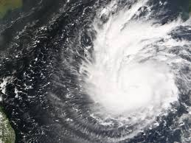
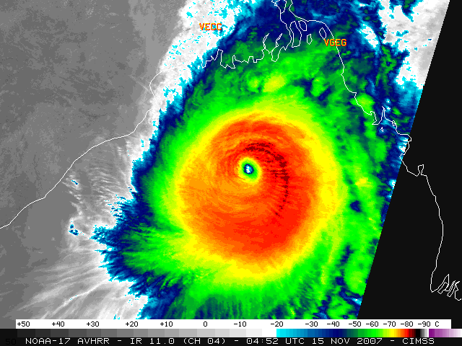
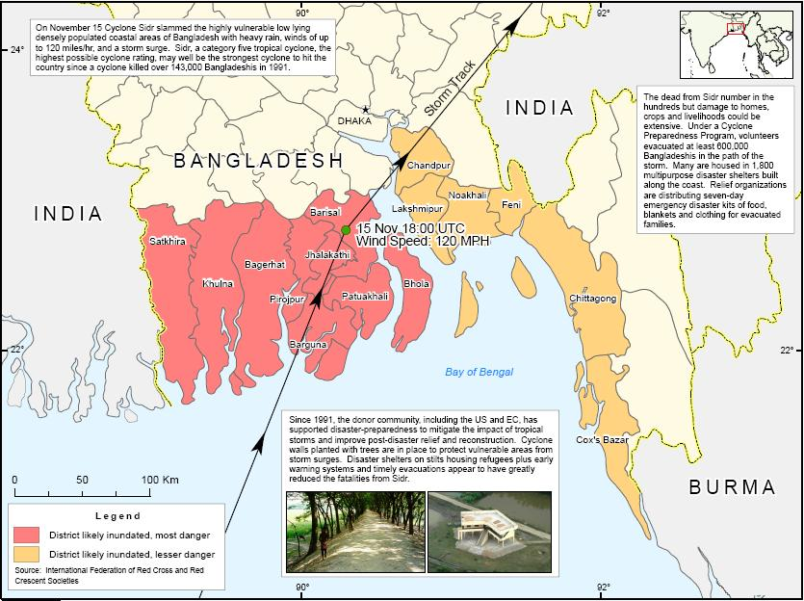
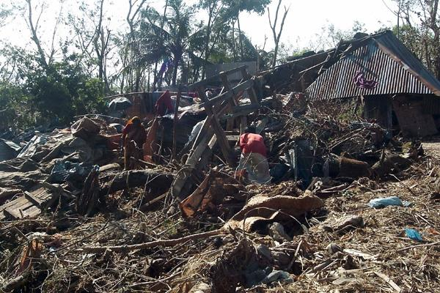
Cyclone SIDR
Bangladesh, November 2007
STAR-TIDES first real-world event
Release of near-real time imagery to disaster response workers

Slide 4
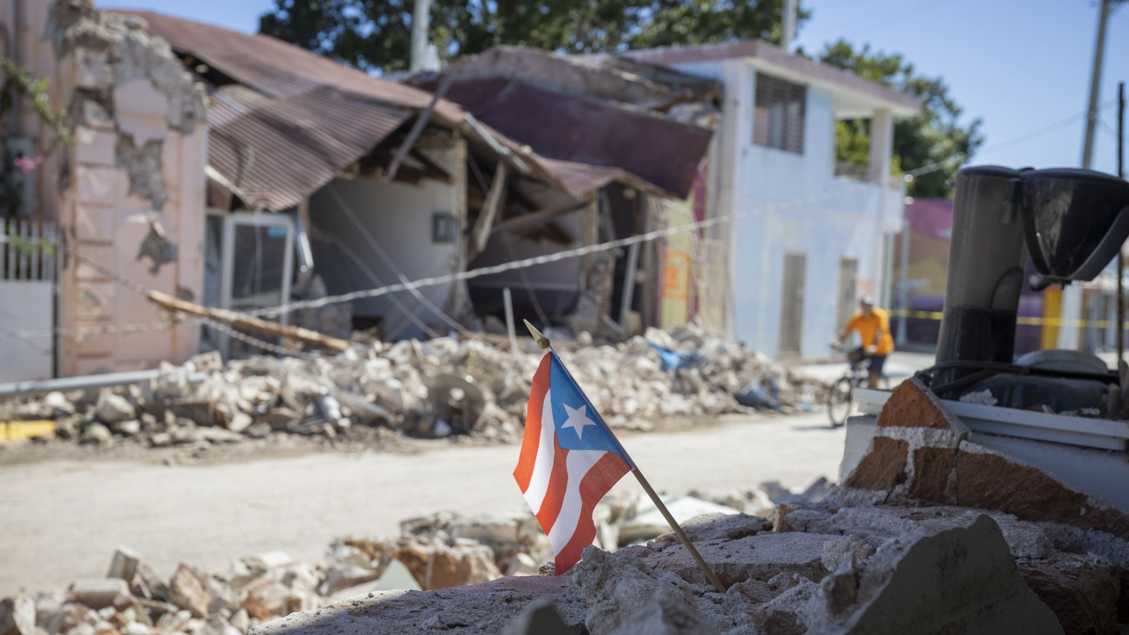

Slide 5
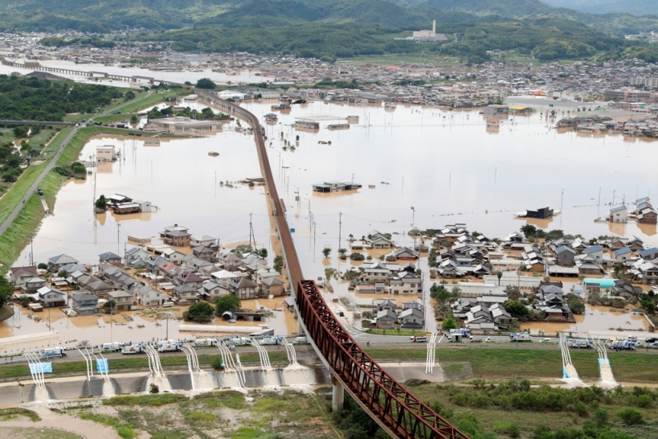

Slide 6
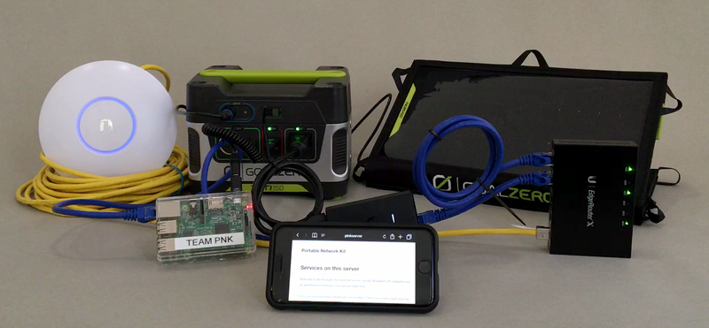
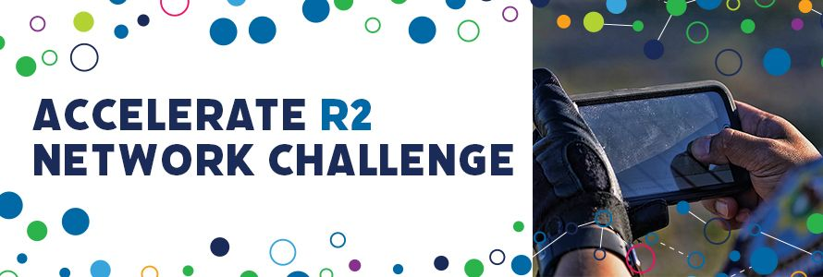

Slide 7
Cloud Migration
Socio-economic pressures often cause best and brightest to migrate or feel marginalized
Often lead to dangerous trips to unwelcoming places
Risks of radicalization
Suppose there were an alternative migration path
Provide skills to learn and earn in place
In their communities with their families and cultures
Expansion of internet provides path for migration “through the cloud”
To learning & earning opportunities
Up to now open only to a privileged few
To promote achievement of sustainable development goals (SDGs)
By encouraging talented people to contribute to their own communities
Tech not a panacea
Solutions must involve people, processes, organizations and technology

Slide 8
Recommendations
Recommend that cloud migration plans:
Anticipate bandwidth enhancements with a focus on human capital development to take advantage of it, including education, health, and security to improve quality of life
Recognize that solutions involve people, organizations, and processes, as well as technology
Build a “governance ecosystem” of government, business, and civil society with a nonpartisan, outside entity to provide continuity across political transitions and economic turbulence
Pursue synchronized, coordinated, integrated approaches that cut across silos

Slide 9
Questions?
linwells@gmail.com, +1.202.436.6354

