Slide 1

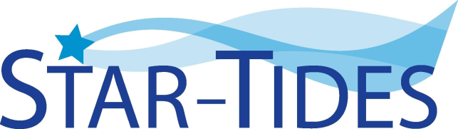
STAR-TIDES
Global Knowledge-Sharing Network
Part 1
Linton Wells II
Center for Resilient and Sustainable Communities (C-RASC), George Mason University
January 12, 2021

Slide 2
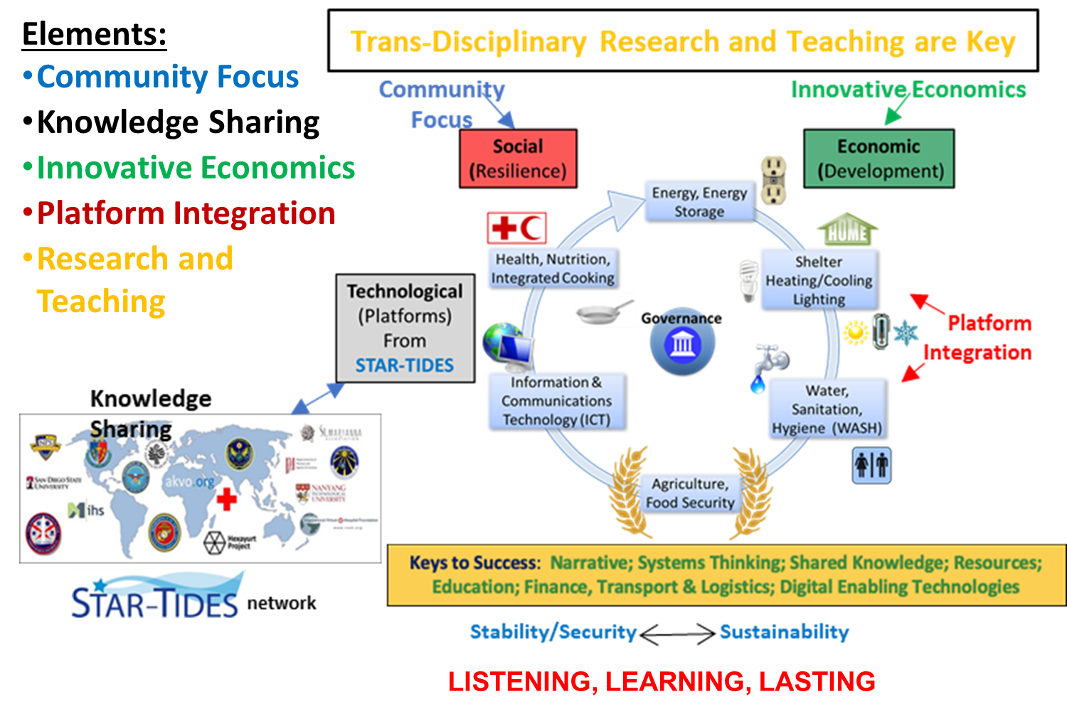

Slide 3

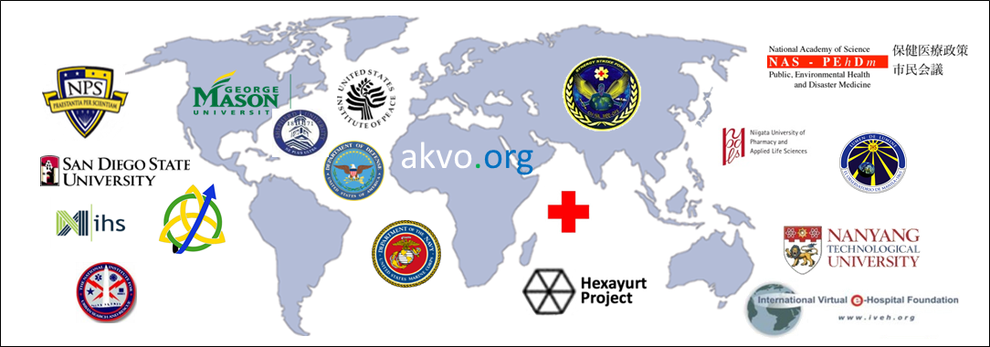
Global Knowledge Sharing

Slide 4
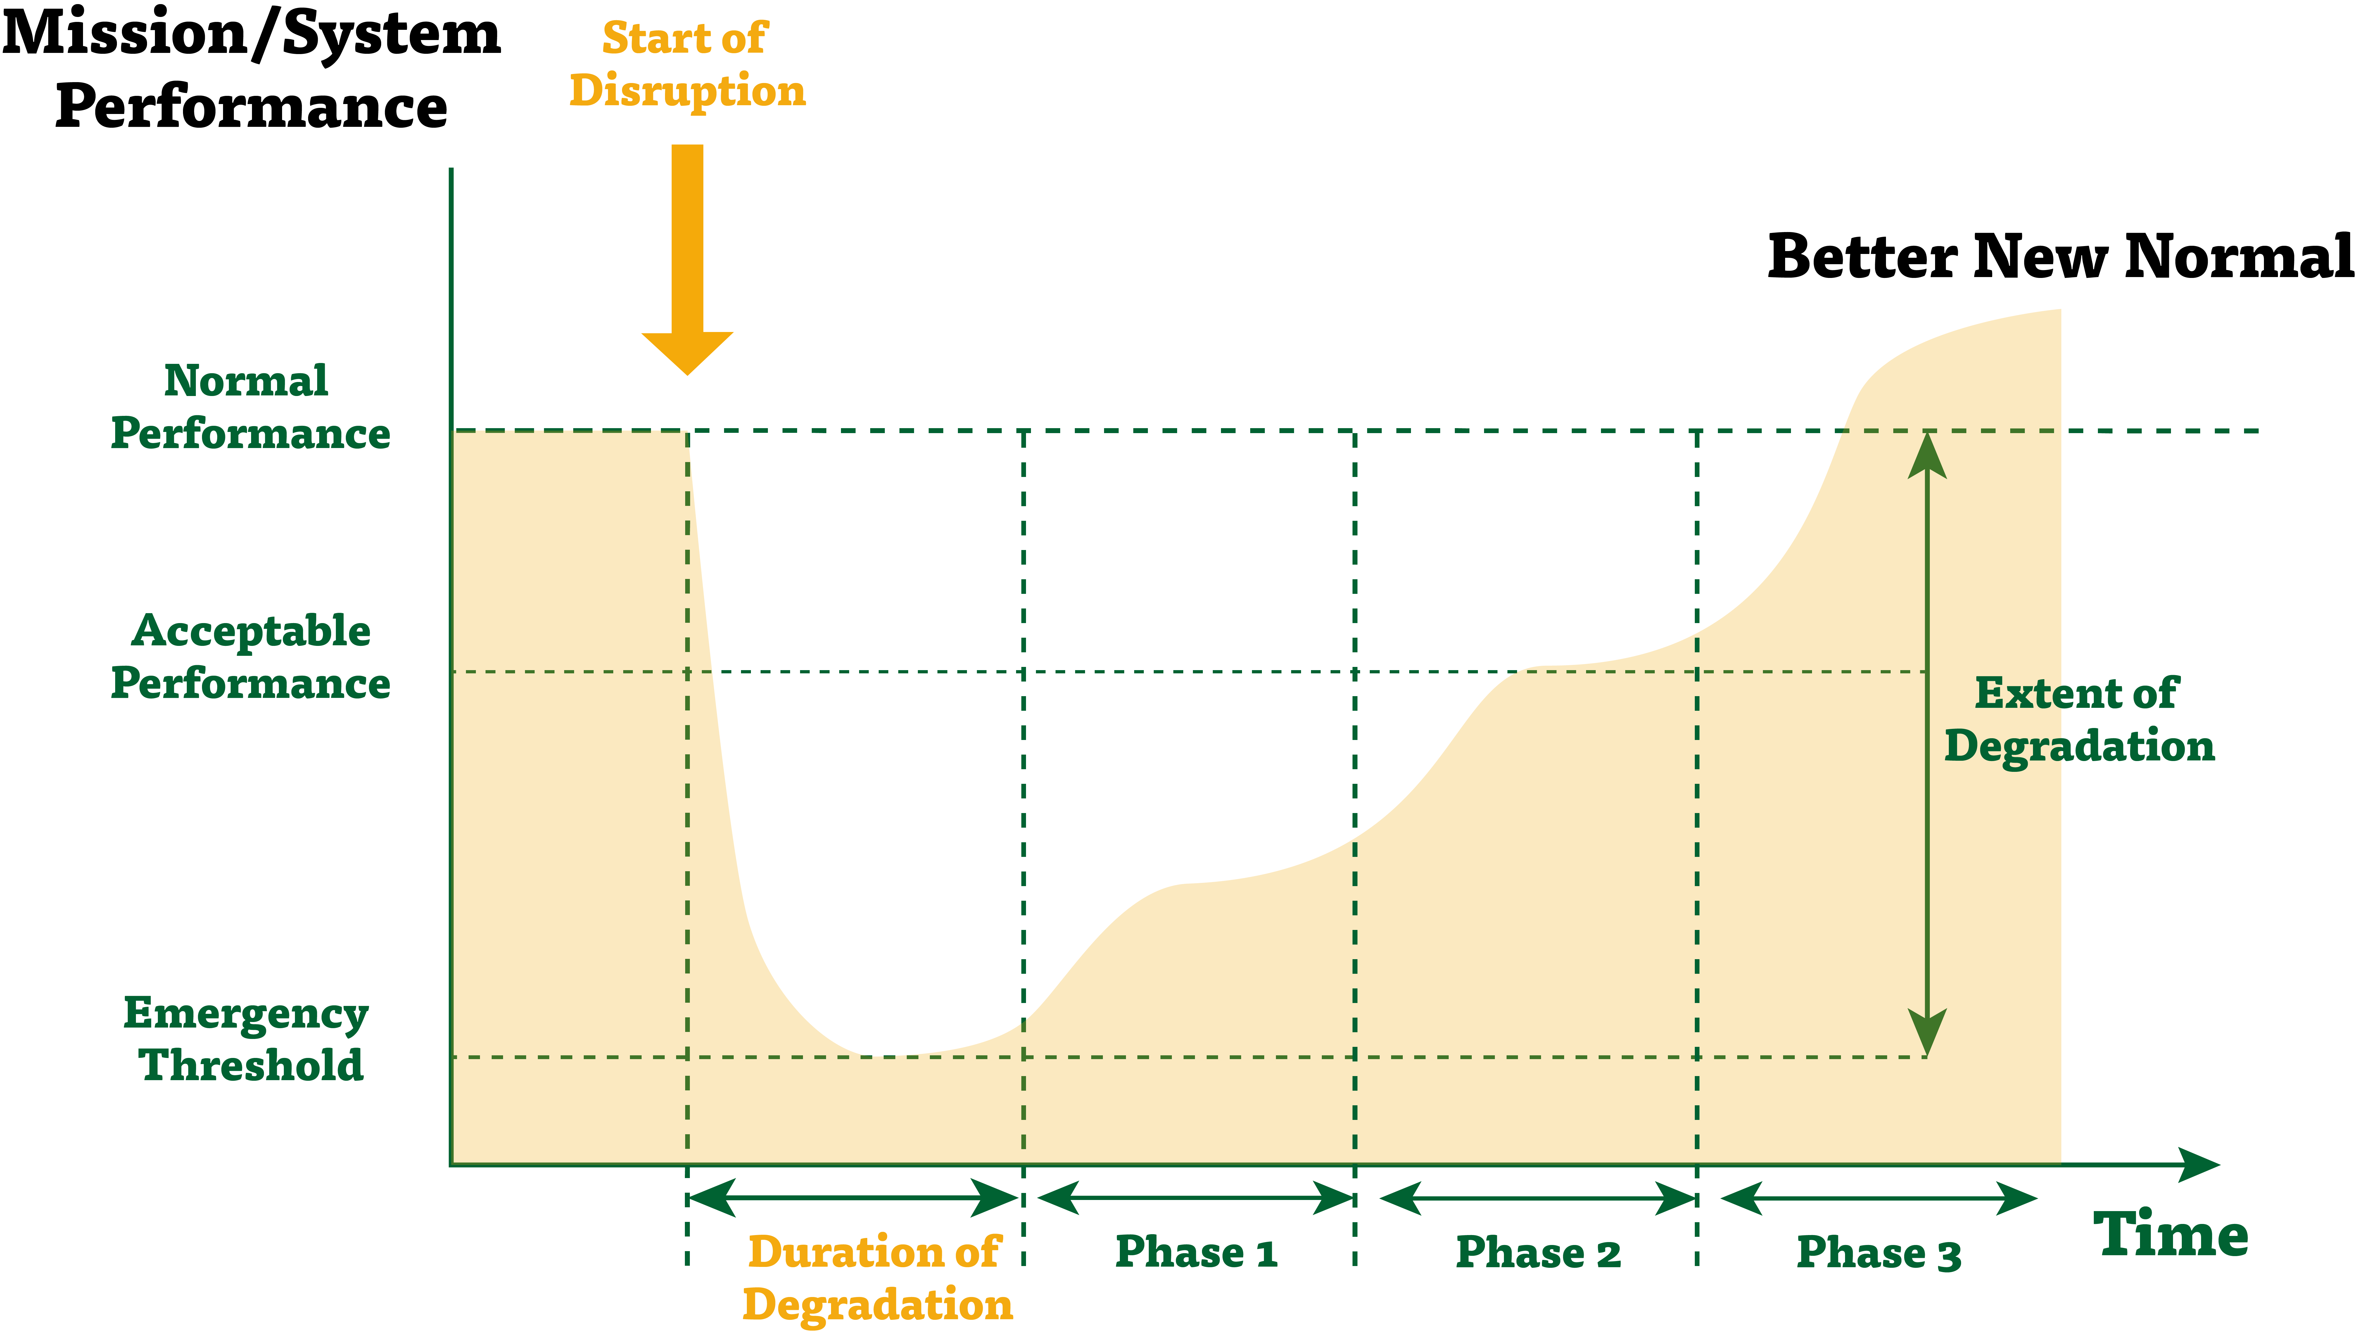
Resilience is NOT Just Bouncing Back.
It’s Being Prepared to Bounce Forward Better
NIST Phases: Anticipate Withstand Recover Adapt/Re-position

Slide 5
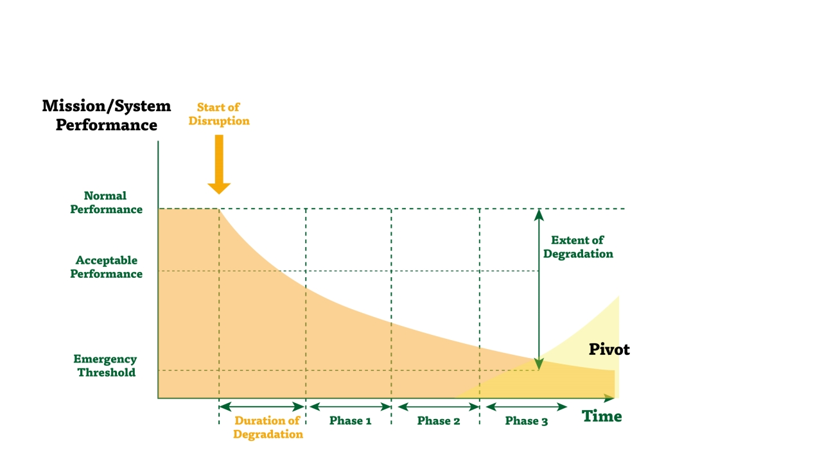

But Sometimes You Need to
ADAPT and PIVOT

Slide 6

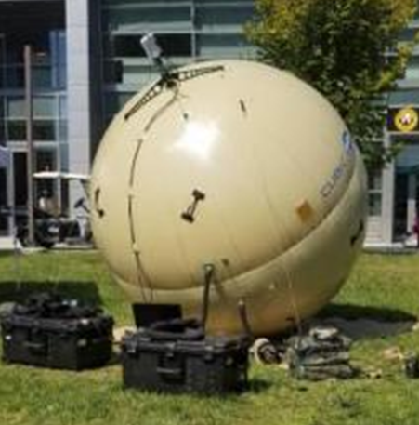

-

Slide 7
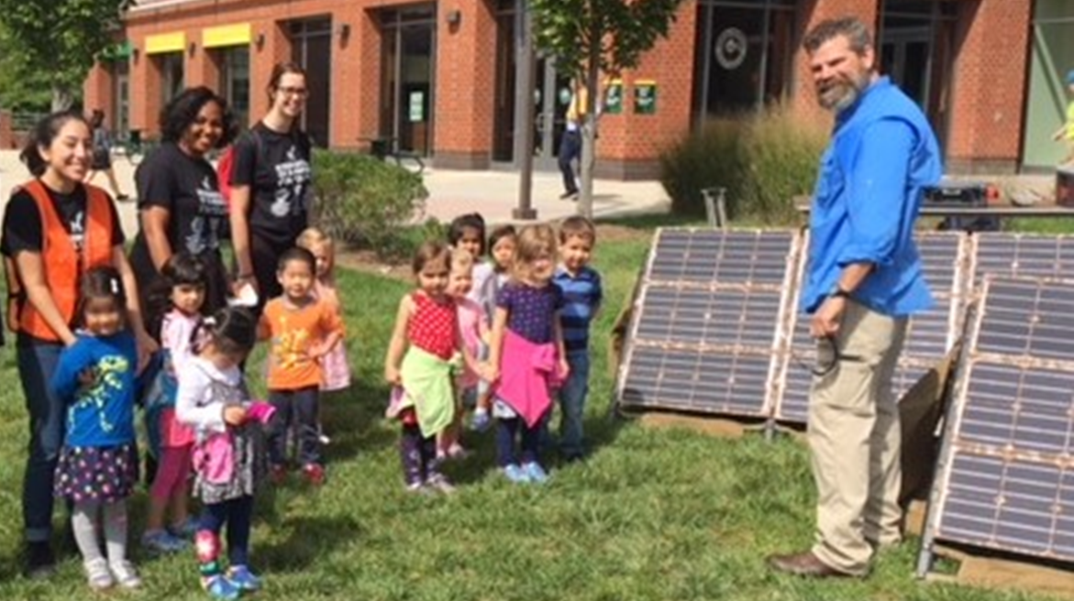
-

Slide 8
2020 STAR-TIDES VIRTUAL CAPABILITES DEMO
Converging Approaches to Sustainable Resilience
Highlight Mason’s Broad Scope
  Three institutes, Sustainable Earth, Digital InnovAtion, and Biohealth Innovation
  Align with World Economic Forum’s view that accelerating, converging technologies are blurring lines between physical, digital, and biological spheres
22 separate events and 10 parallel breakout tracks
  Focused on diverse areas including technologies, narrative and storytelling, and ethics
Thomas L. Friedman’s keynote discussed fast, fused, deep, and open forces that increasingly affect our lives
Sessions generated over 26 hours of content and more than 55 videos
  on YouTube @ TIDESPROJECT/videos and Playlists

Slide 9
Questions?
linwells@gmail.com, +1.202.436.6354

