Slide 1
George Mason University
Center for Resilient & Sustainable Communities (C-RASC)
Dr. Kathryn B. Laskey
Director
Professor, Systems Engineering and Operations Research

Slide 2
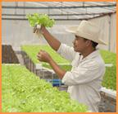
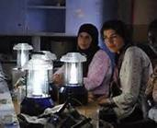
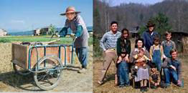
C-RASC Approaches
Build Sustainable Resilience by
LISTENING to community needs
Encouraging two-way LEARNING
Developing LASTING capabilities
Promote Entrepreneurship and Business Development
Reduce Pressures for Migration & Marginalization
Improve Disaster Resilience
Strengthen Critical Infrastructures
Notes:
18:45

Slide 3
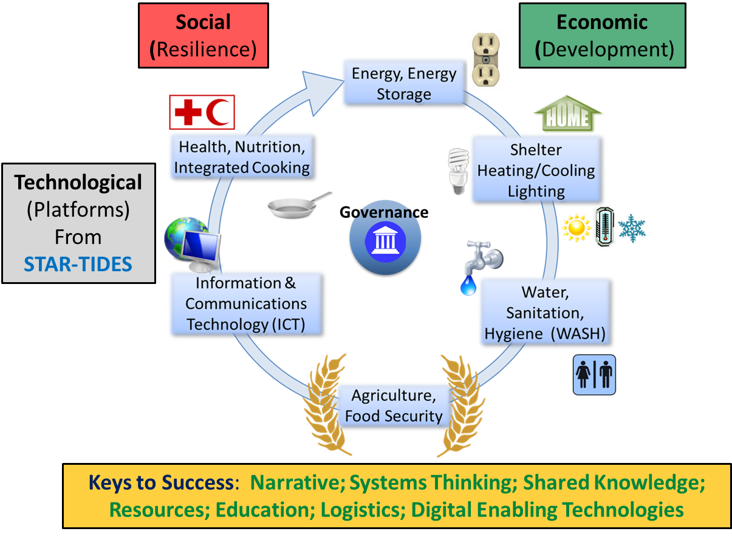
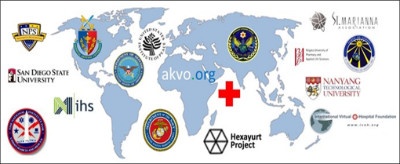
Elements:
Community Focus
Knowledge Sharing
Innovative Economics
Platform Integration
Research and Teaching
Trans-Disciplinary Research and Teaching are Key
Community Focus
Innovative Economics
Knowledge Sharing
via
network
Stability/Security Sustainability
LISTENING, LEARNING, LASTING
Notes:
22:00

Slide 4
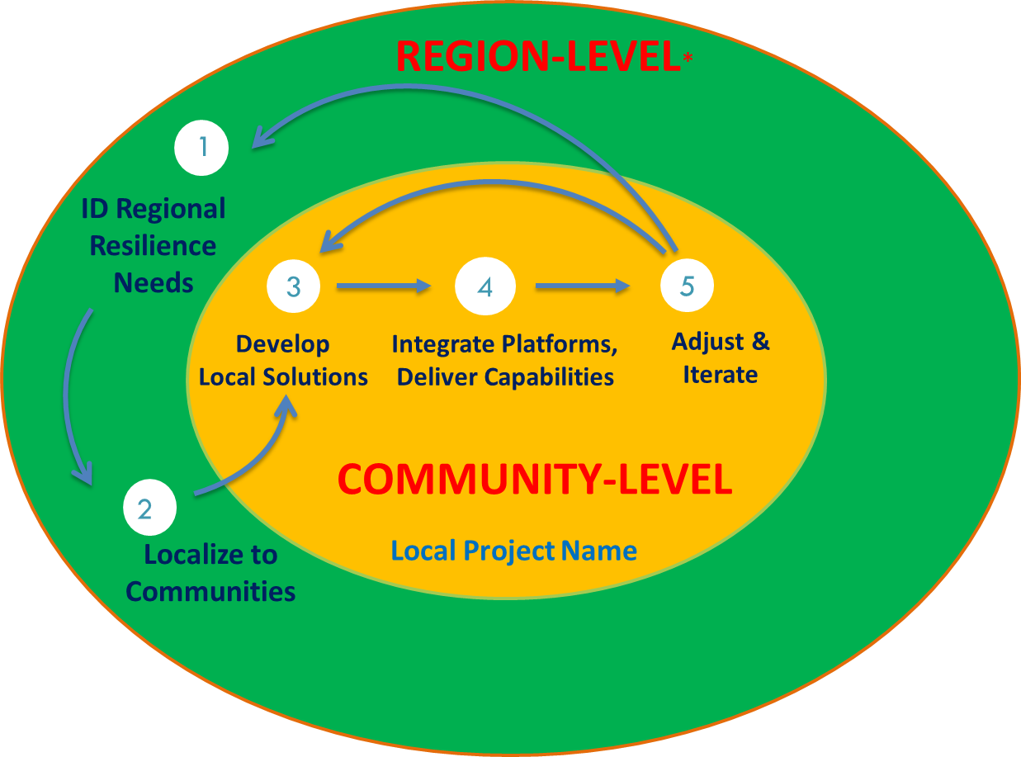
Region Community
Notes:
22:30

Slide 5
Broad Partnerships
Collaborative Opportunities
- Narrative & Storytelling - Cybersecurity
- Critical Infrastructure Protection - Public Policy
- Conflict Analysis & Resolution - Sociology
- Business & Economics - Public Health
- Geospatial Info Systems - Education
- Transport and Logistics - Systems Thinking
- Entrepreneurship - Climate Science
- Specific Technologies and Engineering Disciplines
Within University:
College of Science
School of Business
Volgenau School of Engineering
College of Health and Human Services
Schar School of Policy and Government
Carter School of Peace and Conflict Resolution
Outside partners
Real World Engagements
Complex Adaptive Threats (with Virginia Commonwealth Cyber Initiative)
Ethiopian Subsistence Irrigation Project
Appalachia Advancing (with Shepherd University)
Puerto Rico Science & Technology Research Trust (with STAR-TIDES Latin America core group)
Rural Broadband (with People-Centered Internet)
Japan STAR-TIDES Network
15th STAR-TIDES Capability Demo Oct 18-20@GMU
Notes:
23:15

Slide 6
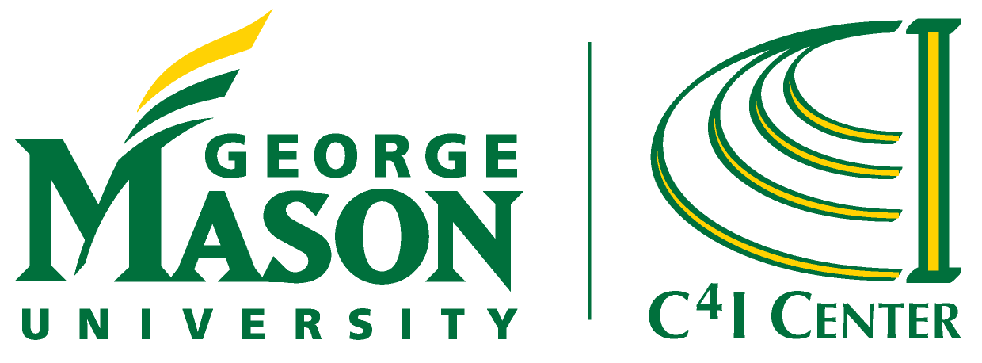
The goal is to “Make hope possible, rather than despair convincing”—Raymond Wilson
Governance and institution-building will be key
Must understand what dignity, justice and fairness mean in whatever culture is at the center of a particular project—technical solutions alone
are never enough
Notes:
The goal is to “Make hope possible, rather than despair convincing”—Raymond Wilson
Governance and institution-building will be key
Must understand what dignity, justice and fairness mean in whatever culture is at the center of a particular project—technical solutions alone
are never enough
23:30

